Slide 1

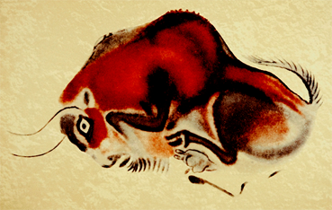
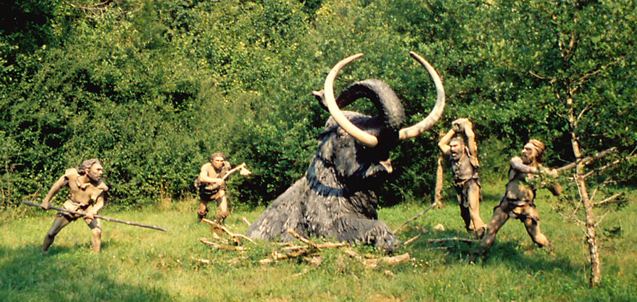
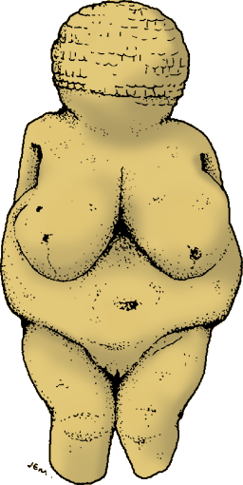
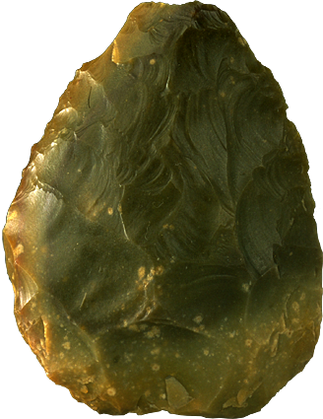

Human Evolution Series: Set 3
Copyright © 2005
Version: 2.0
Notes:
*

Slide 2
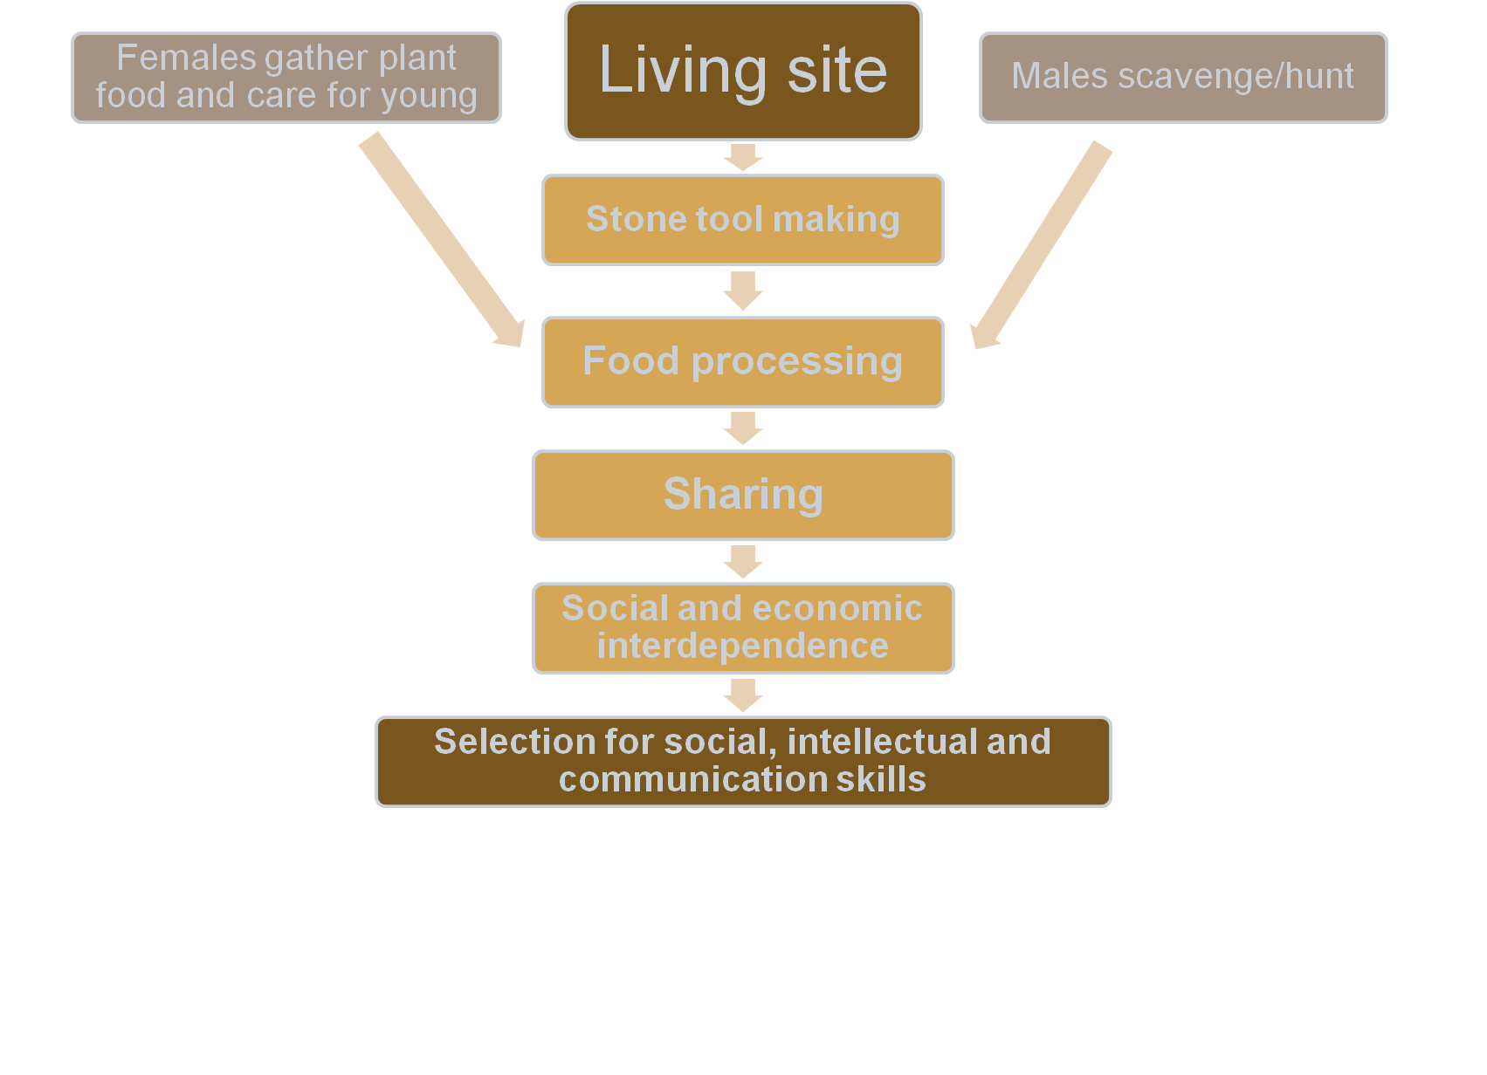
Advancements due to Shelter
With shelter early humans could:
Provide shelter from the elements and safety from predators: Safety out of the weather meant that they would stay warm dry and probably decreased sickness. They would be able to defend themselves better in shelter than out in the open
Home base: A community was built around food sharing and division of labor which allowed for greater protection of young by being cared for at home base and increased skills by diversification
Notes:
*

Slide 3
Advancements due to Shelter
With shelter early humans could:
Provide shelter from the elements and safety from predators: Safety out of the weather meant that they would stay warm dry and probably decreased sickness. They would be able to defend themselves better in shelter than out in the open
Home base: A community was built around food sharing and division of labor which allowed for greater protection of young by being cared for at home base and increased skills by diversification
Notes:
*

Slide 5
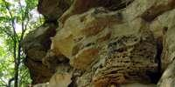
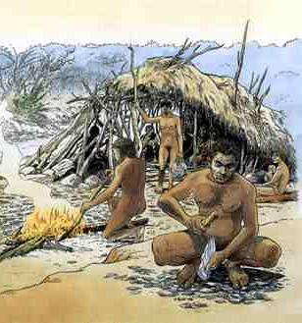
Homo habilis use of Shelter
Homo habilis:
Homo habilis were usually on the move to find food, so they did not stay in one place for very long.
For shelter, they used cliffs, hills, and fallen trees. They didn't live in caves because there was predators in them like bears. There tool making was still very early so they couldn't really defend themselves and they didn’t control fire. (Same with earlier hominids).
Around 2 million years ago, Homo habilis is believed to have constructed the first man-made structure in East Africa, consisting of simple arrangements of stones to hold branches of trees in position.
Notes:
*

Slide 6
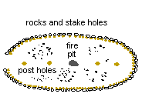
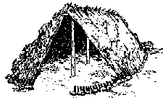
Homo erectus use of Shelter
Homo erectus:
They were able to inhabit caves due to control of fire which scares of predators
They also constructed shelters by placing wooden poles in the ground supported by blocks of stone
A site called Terra Amata, located on the French Riviera seems to have been occupied by H. Erectus. They found evidence of what might have been 21 separate oval living floors within branch and brush huts on the beach. These were up to 12 m long and 6 m wide.
They were able to heat their homes with fire.
Notes:
*

Slide 7
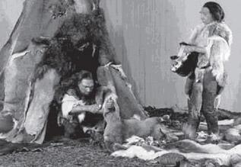
Neanderthals use of Shelter
Homo neanderthalensis:
They constructed wind breaks over cave openings with poles holding up hides or with piles of stones
Like homo erectus they constructed tents, as big as 9m by 7m and 10m high. They used fire to warm their homes and frighten off predators.
Notes:
*

Slide 8
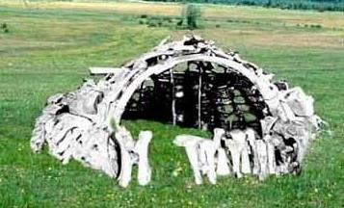
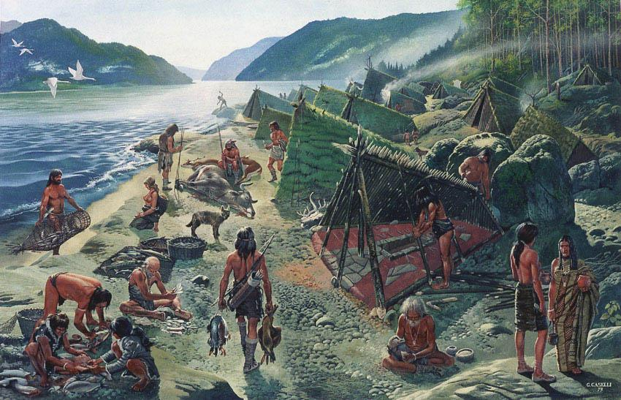
Homo sapiens use of Shelter
Homo sapiens:
As well as possible use of caves, they built permanent homes for the winter and in summer followed herds living in tents
Winter homes were made from branches and mammoth bones covered with animal skins sewn in place
Some held only a small group of people
Long huts had several entrances, with rooms and fires
In summer they had tents that could be moved from place to place
Notes:
*

Slide 9
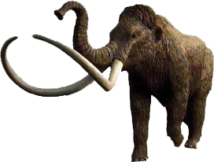
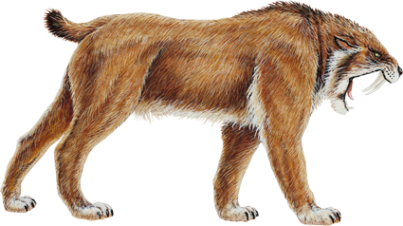
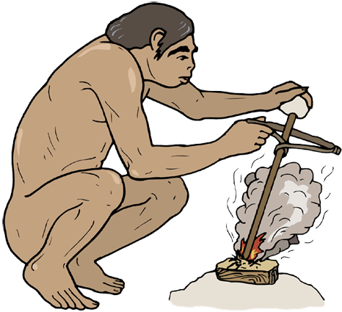
Advancements due to Fire
With fire early humans could:
Remain active at night: People began using fire as a source of light to continue their activities after dark and inside their caves.
Cooking with fire: Made the meat of the animals and plants more palatable digestible, and destroyed some parasites/toxins allowing them to exploit new food sources. Ability to preserve meat by smoking it over a fire, vastly decreasing the danger of periodic starvation.
Make better weapons and tools: Hunters formed spears from tree branches by burning the tips of the branches and then scraping the charred ends into a point.
Protect themselves from predators
Warm themselves: This allowed them to adapt to cooler climates, extending their habitat range
Social gathering: A cheery comfortable atmosphere was likely important for social bonding and sharing of ideas and behaviors
Notes:
*

Slide 10
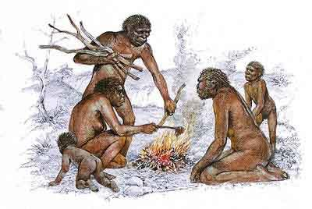
Homo erectus use of Fire
Homo erectus:
The earliest record of humans using fire was in Africa 1.5mya during the time of Homo erectus.
At first, fire may have been ‘captured’ from natural sources, such as bush fires caused by lightning
It is unlikely Homo erectus could create fire. They possibly carried it from place to place by keeping live embers alive
Homo erectus used fire for cooking food
Fire allowed Homo erectus to move out from the homeland of Africa into Europe and Asia
Notes:
*

Slide 11
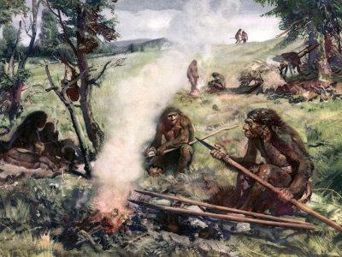
Neanderthals use of Fire
Homo Neanderthalensis:
The Neanderthals controlled fire within hearths of stone which were reused.
Slabs of stone showed signs of continued reheating…They were likely used to cook on and were heated up by being placed in a fire
It is likely that the Neanderthals were among the first to start smoking and drying meats and hides (although it is possibly earlier)
They used fire to make fire hardened points on spears
A burnt bear bone found deep in a cave proved they used fire for illumination.
Notes:
*

Slide 12
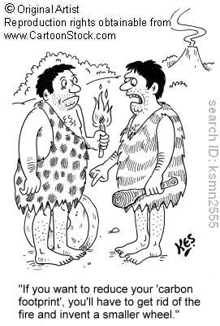
Homo sapiens use of Fire
Homo sapiens:
Like the Neanderthals, Homo sapiens contained fire in hearths, cooked and smoked meat and dried hides and fire hardened tools like spears
They possibly were able to create fire by this stage of development
Notes:
*

Slide 13
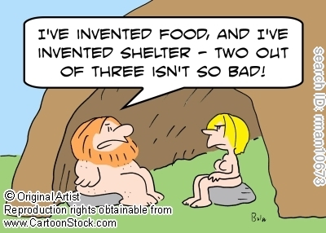
Advancements due to Clothing
With clothing early humans could:
Keep themselves warm: The evolving of short fine body hair meant more susceptibility to weather. Clothing allowed them to keep warm and also adapt to cooler climates, extending their habitat range
Social identity: Clothing can show identity in terms of ethnicity, gender and class. Pendants and beading could also show level of success (If they had time to make beads then they must have been well prepared in terms of hunting and storage of food)
There is no evidence of homo erectus use of clothing
Notes:
*

Slide 14
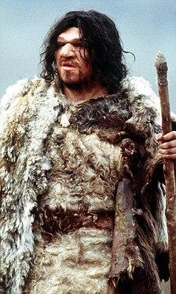
Neanderthals use of Clothing
Homo neanderthalensis:
The first known humans to make clothing are the Neanderthals.
It is believe hides were cut into shapes with holes made for the head and perhaps the arms, then draped over their bodies. They may have used thin strips of hide to tie the furs about themselves.
They produced pendants by drilling holes in animal teeth and stringing them on twine or sinew
It is unlikely that they produces anything woven or textile-like, thought they may have bound grasses or reeds together for various purposes.
Notes:
*

Slide 15
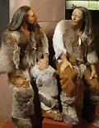
Homo sapiens use of Clothing
Homo sapiens:
They would have used hides and fur of improved design with the advancement in tools such as needles to sew hides together
They also produced pendants by drilling holes in animal teeth and stringing them on twine or sinew
They decorated their bodies with paint and tattoos, made from natural dyes (possibly signs of social standing)
Finds of spun, dyed, and knotted flax fibres among Cro-Magnon artefacts in Dzudzuana shows they made cords for sewing garments, and suggest that they knew how to make woven clothing
Notes:
*

Slide 16

Notes:
*

Slide 17
Terms of Use
Biozone International retains copyright to the intellectual property included in this presentation file, with acknowledgement that certain photos are used under license and are credited appropriately on the next screen.
You MAY:
Use these slides for presentations in your classrooms using a data projector, interactive whiteboard, and overhead projector.
Place these files on the school’s intranet (school computer network), but not in contradiction of clause 3 (a) below.
Edit and customize this file by adding, deleting, and modifying information to better suit your needs.
Place these presentation files on any computer within the school, including staff laptops.
Print out this file in PowerPoint “Handouts” format as per the print dialogue box, for the express purpose of allowing students to make their own notes about the presentation.
You MAY NOT:
Put these presentation files onto the internet or on a service that may be accessed offsite from the campus, unless access to the service is protected by a user login and password protocol.
Print these files onto paper to make your own worksheets for distribution to students.
Create a NEW document using any of the graphics/images in this presentation file.
Incorporate any part of this presentation file for the production of another commercial product.
REMOVE any of the references to Biozone, the copyright notices, photo credits, or terms of use from this file.

Slide 18
Photo Credits
Photographic images are used under licence from the following photo libraries:
Corel Corporation Professional Photos
ArtToday.com, Clipart.com
iStockPhotos.com
PhotoDisc Inc.
Hemera Technologies Inc.
PhotoObjects.com
Photos.com
SkullsUnlimited.com
Additional artwork and photographs are the property of Biozone International Ltd.
BIOZONE International Ltd | P.O. Box 13-034, 109 Cambridge Road, Hamilton, NEW ZEALAND
Phone: + 64 7 856-8104 | Fax: + 64 7 856-9243 | E-mail: sales@biozone.co.nz | Internet: www.biozone.co.nz
Copyright © 2005 Biozone International Ltd
All rights reserved
Notes:
*

Slide 19







Presentation MEDIA See our other titles:
See full details on our web site:
www.thebiozone.com/media.html
Notes:
*

